Slide 1
Final Project Presentation
Dongyu Zhu
Taught by Professor Shengzhi Zhang

Slide 2
Project analysis slide 2
Project Analysis
Data Preparing
Introduction
PROJECT
Analysis
Conclusion

Slide 3
Project analysis slide 3
Introduction
Picking the dataset
Preparing data
Data ANALYSIS
Conclusion
In the process of preparing the data, I need to clean up some unneeded data, and some customers incorrectly fill in the data to make the data more effective.
Through the collation and analysis of the data, the corresponding chart is obtained to illustrate the meaning of data and the trend of data change.
For this final project, I used the data of the BodaBrog in Boston area in November.
Explain and analyze the meaning of the data

Slide 4
Project analysis slide 8
Data preparing
Preserve
Delete
Read the Boda Borg data that contains visiting history of November 2017 and keep the proper formats, like I preserve Date，Distance, Customer age and so on.
Remove meaningless rows and useleless columns
Use Which function to select the date of age from 10-70, and it can show clearly about the real data
Row data
Row data

Slide 5
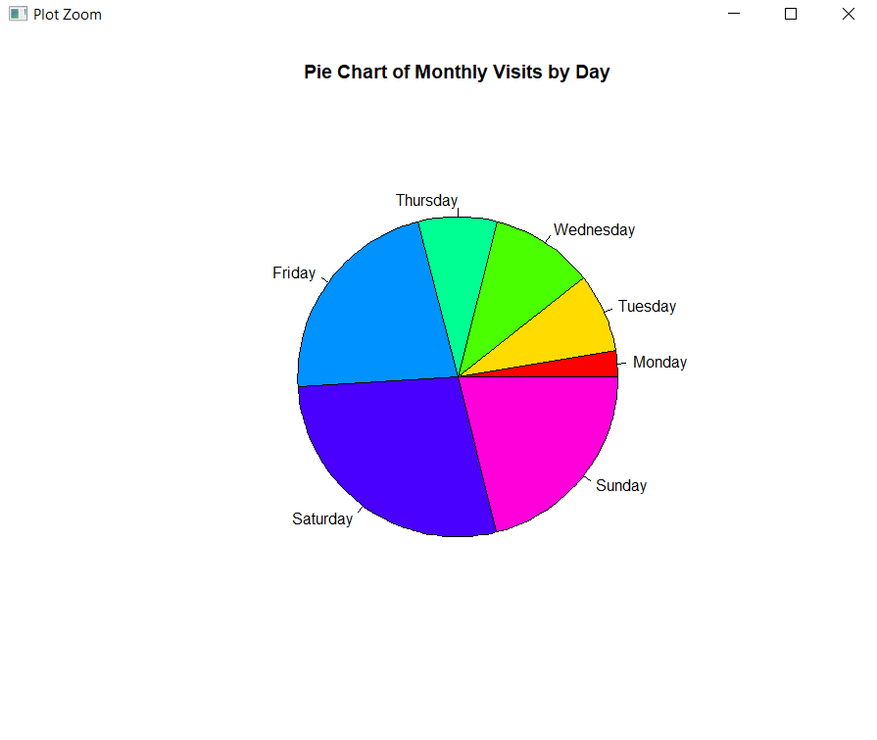
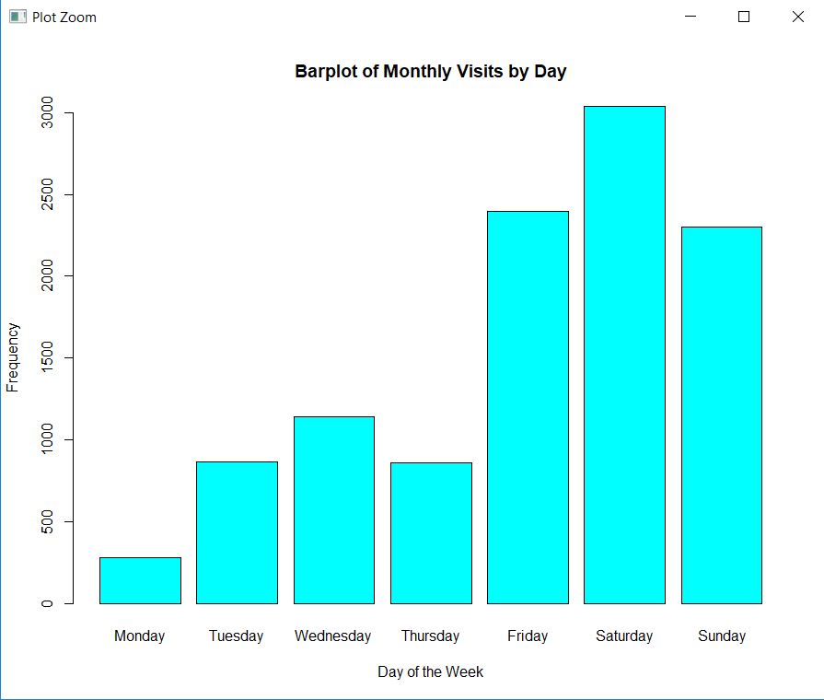
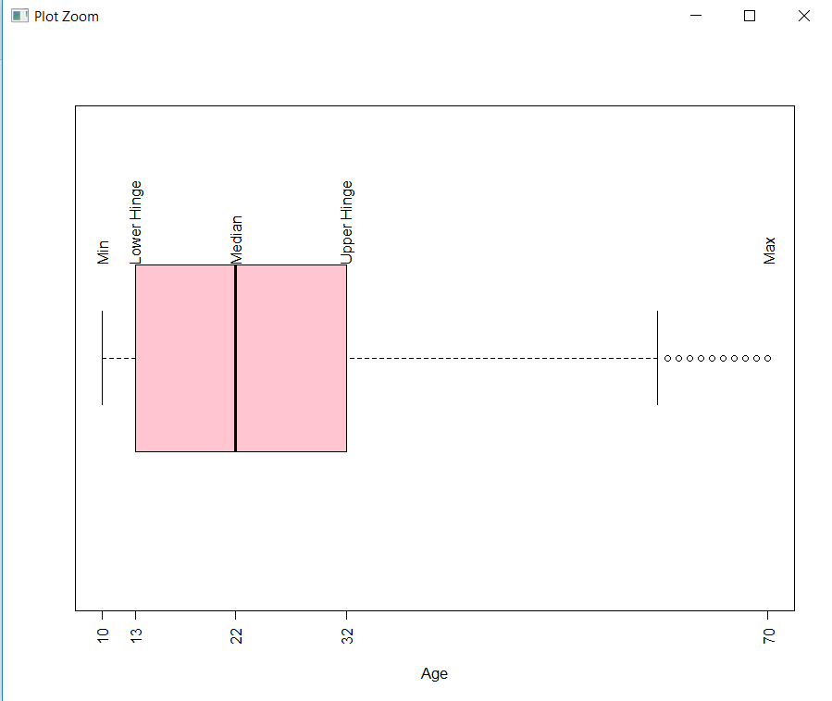
Project analysis slide 5
Project Analysis
Data select
Chart categories
Meaning
As we can see in these two graph, people prefer to choose play in BodaBrog in weekends and Friday. As we can see in these two graph, the people who play in BodaBrog have median age is 22.
I select categories data of the project is the monthly visits by days
Use pie, bar chart, and boxplot, Plots of categorical variable: Day
Plot of numerical variable: Age

Slide 6
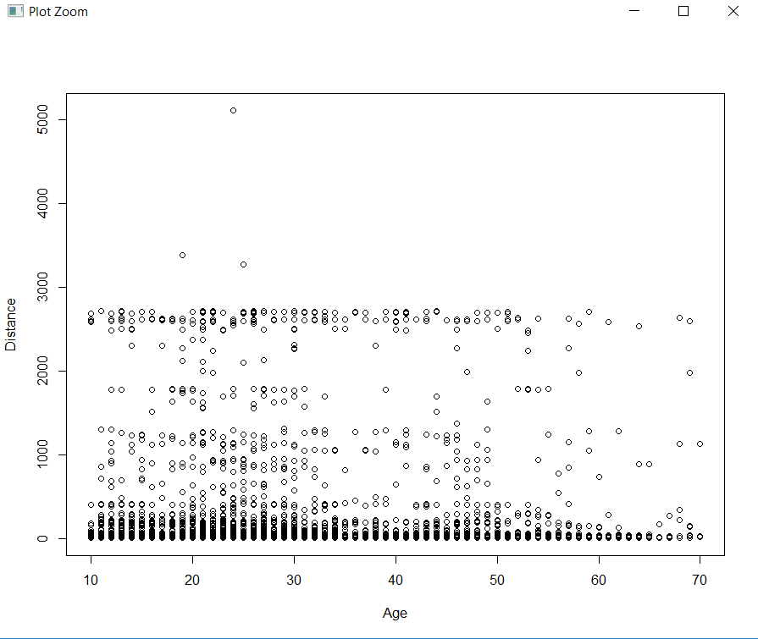
Project analysis slide 5
Project Analysis
Data select
Chart categories
Meaning
As we can see in this graph, I select the data from Bodabrog, the distance and age does not has a correlation
I select numeric data of the project is the player’ age and distance from home to BodaBrog
Use the point plot , Plot of a set of two numerical variables: Age & Distance

Slide 7
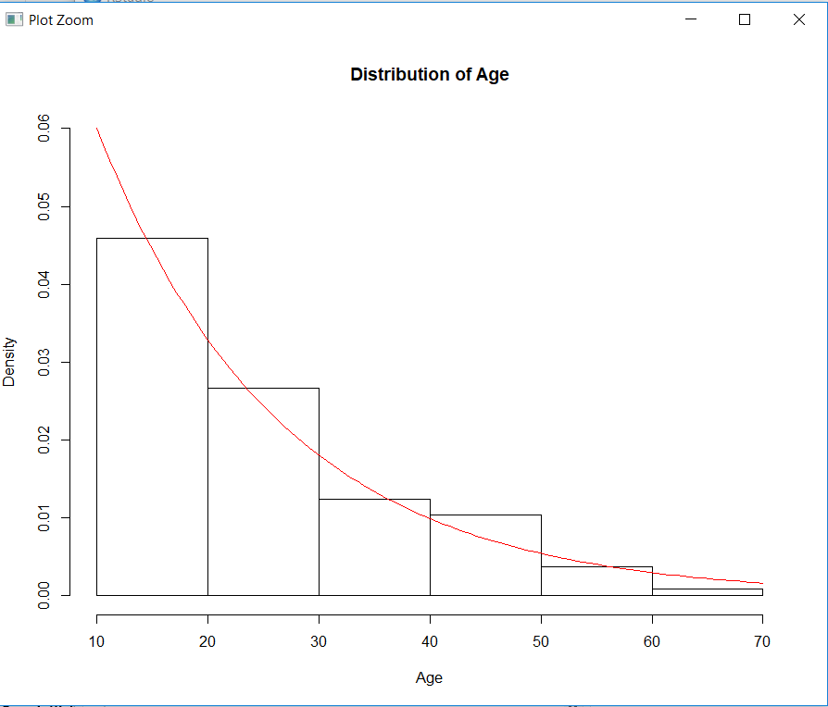
Project analysis slide 5
Project Analysis
Data select
Chart categories
Meaning
As we can see in this graph, the people who play in BodaBrog has a dive trend in the graph. Through the graph, you can see that the number of people who are playing has decreased with age, and the number is also showing a correlation.
I select numeric data of the project is the player by age
Use boxplot and bar and curve chart. Fit the distribution of data using exponential distribution with proper parameters.

Slide 8
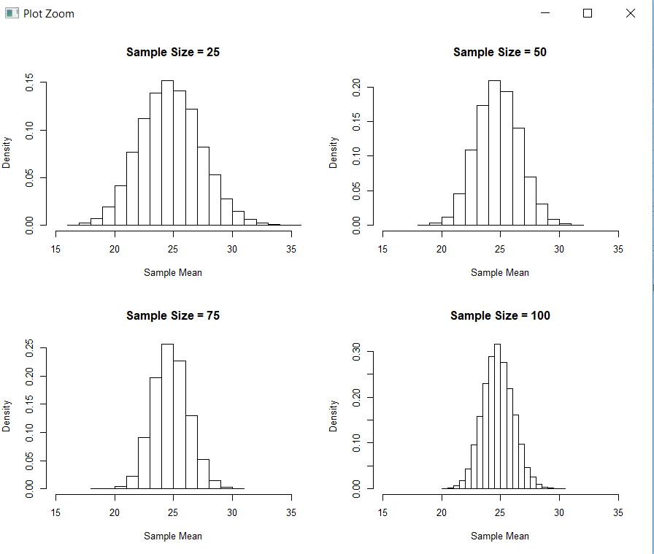
Project analysis slide 5
Project Analysis
Data select
Chart categories
Meaning
According to the definition of Central Limit Theorem and the examples in Module 5, I applied 3 different sampling methods to examine the distribution of sample means. For each sampling method and each sample size, I sampled the data thousands of times and stored the sample means in a vector.
I select numeric data of the project is the player by age
Use histplot, Applicability of Central Limit Theorem for Age variable under different sampling methods

Slide 9
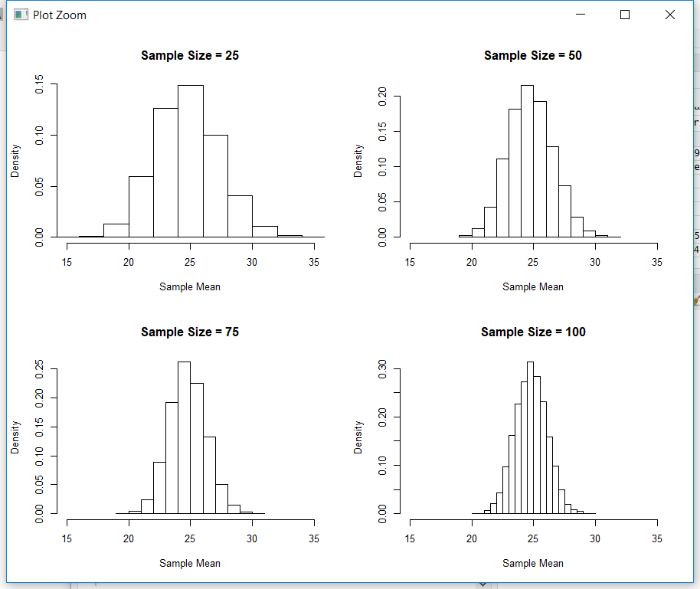
Project analysis slide 5
Project Analysis
Data select
Chart categories
Meaning
According to the definition of Central Limit Theorem and the examples in Module 5, I applied 3 different sampling methods to examine the distribution of sample means. For each sampling method and each sample size, I sampled the data thousands of times and stored the sample means in a vector.
I select numeric data of the project is the player by age
Use histplot, Applicability of Central Limit Theorem for Age variable under different sampling methods

Slide 10
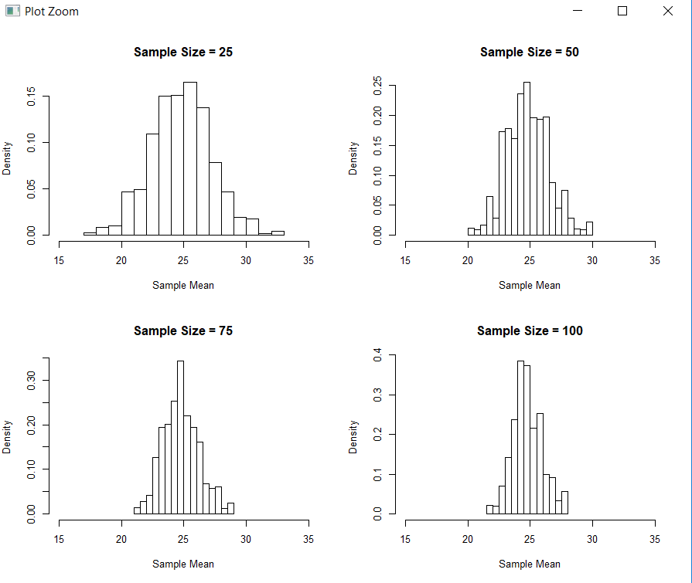
Project analysis slide 5
Project Analysis
Data select
Chart categories
Meaning
Each set of histograms generated using the sampling methods show that as the sample size increases, the distribution of sample means gets closer and closer to a normal distribution. Systematic Sampling doesn't look so good as Simple Random Sampling in this case.
I select numeric data of the project is the player by age
Use histplot, Applicability of Central Limit Theorem for Age variable under different sampling methods

Slide 11
Project analysis slide 3
Conclusion
Data
Two numeric data has no correlation
It shows a dive trend that the customers‘ number decrease as the number of age grows up.
Friday and weekends is the most popular and welcome day for BodaBrog
The distribution of sample means gets closer and closer to a normal distribution.
For this final project, I used the data of the BodaBrog in Boston area in November.

Slide 12
Thank You

